Slide 1
Task Recursion & Scheduling
Jonathan Liem Zhuan Kim U1520775F
Nicholas Koh Ming Xuan U1522485D
Group: Swensens
CE4053 Embedded Systems

Slide 2
Changes
Modifications
OS_TCB struct
OS_TickTask function
OSSched function
New
OSRecTaskCreate function
OSRecTaskDelete function
OS_revive_rec_task function (internal)
OS_REC_HEAP struct (internal)
node struct (heap node)

Slide 3
Flow of Events
OSRecTaskCreate
Push TCB to heap
Assign priorities (RM)
Run all 5 tasks at start
Once run to completion, run OSRecTaskDel.
TCB is not truly deleted
When t=next_time, OS_revive_rec_task finally enters.
Grabs top of heap, restores TCB and put into ready list
Pop TCB that was restored, and push it in again with a new time to release.

Slide 4
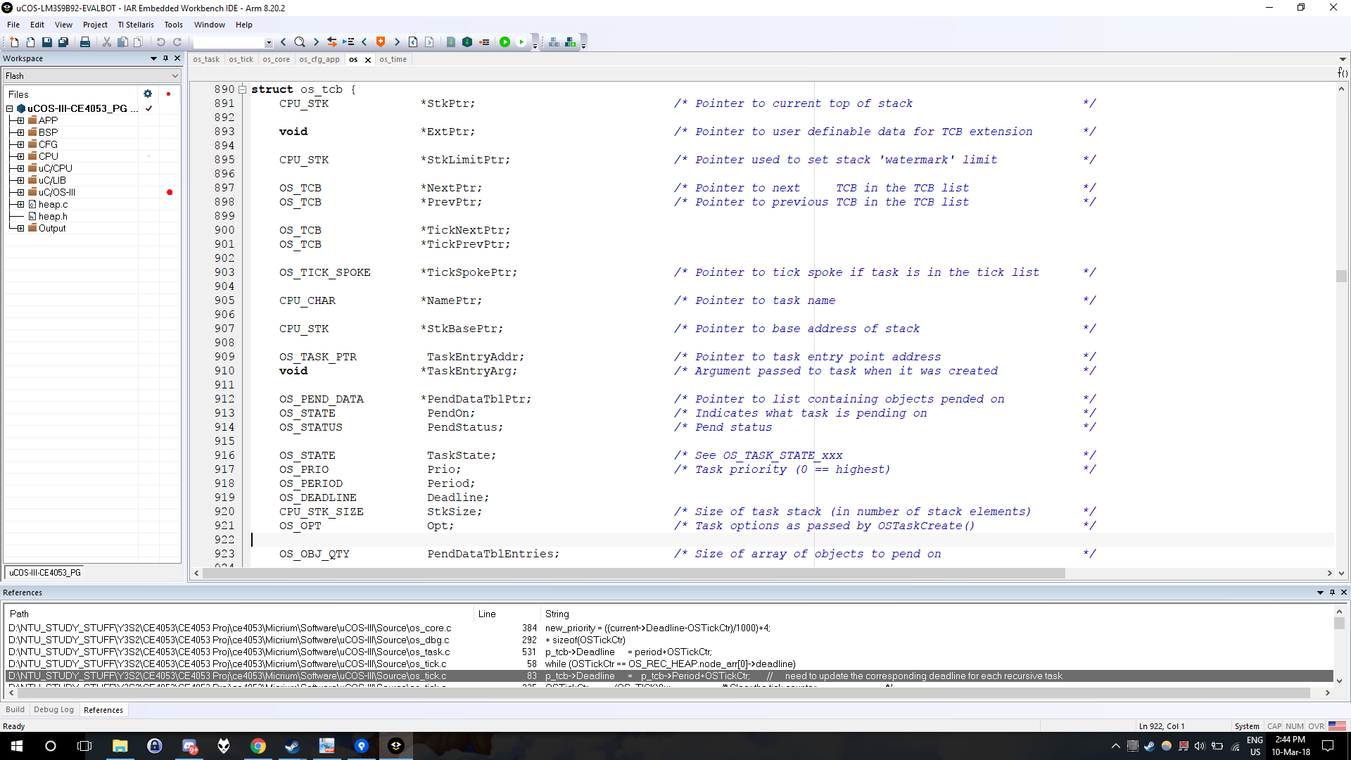
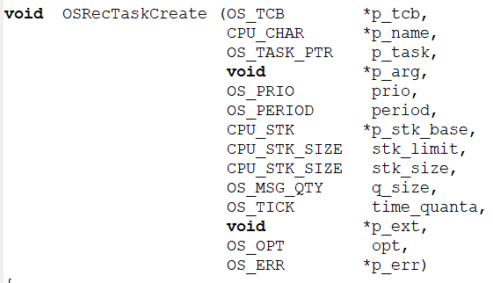
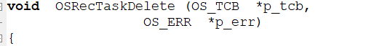
Recursion-API
User has to use these two functions, instead of the original OSTaskCreate and OSTaskDelete.
New parameter of period in OSRecTaskCreate.
Period is in milliseconds.

Slide 5
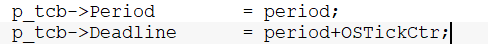
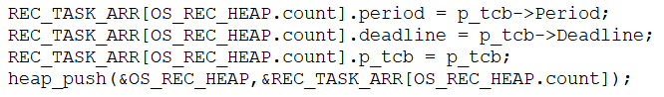
Recursion-OSRecTaskCreate
Internals similar to OSTaskCreate
Initialises TCB and assigns stack
Stores time to next release, as Deadline value.
Stores this TCB pointer in the heap
For synchronous release
Add tasks to ready list, same as OSTaskCreate.

Slide 6
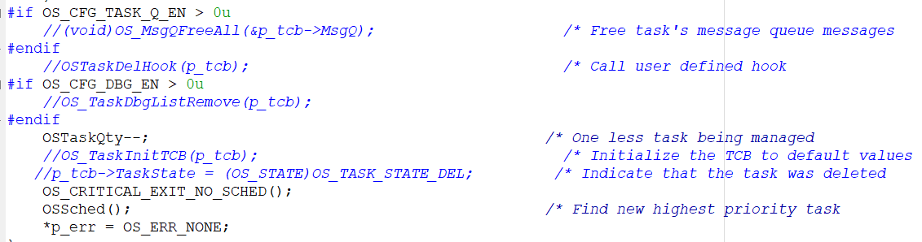
Recursion-OSRecTaskDel
From µC/OS-III User’s Manual, “Deleting a task does not mean that the code is removed, but that the task code is no longer managed by µC/OS-III.”
Does not remove the Task from the OS.
Does not reset TCB & stack. → OS_TaskInitTCB(p_tcb)
The TCBs stored in the heap are untouched.

Slide 7
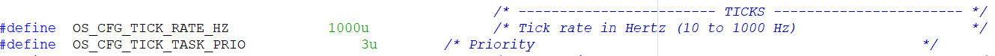
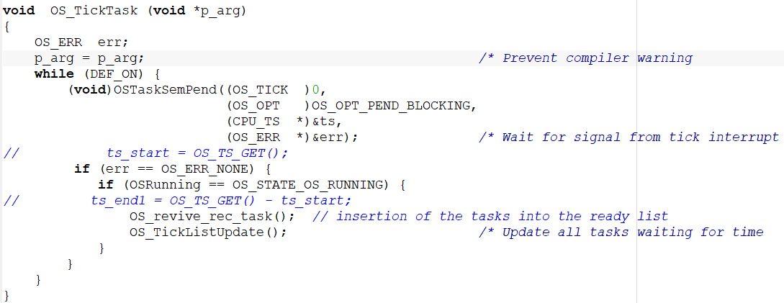
Recursion-OS_TickTask
OS_TickTask runs every 1ms.
Will run OS_revive_rec_task() every time OS_tick task is called.

Slide 8
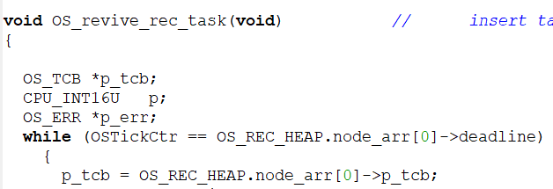
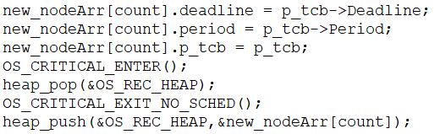
Recursion-OS_revive_rec_task
Compare top of heap (min value) to OSTickCtr.
Run steps in OSTaskCreate
Clear and initialise stack, update TCB values.
Update deadline to next release.
Add to ready list etc.
Remove top (w/ old deadline), replace with refreshed TCB (w/ new deadline)

Slide 9
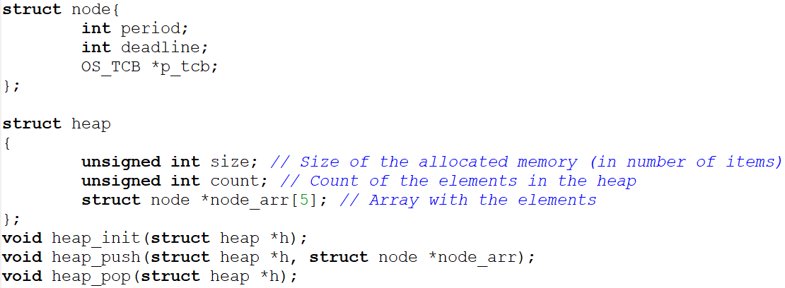
Recursion-Heap
Array used, as every successive level of the tree must fill up from left to right.
Pop, push like a stack is used, due to addition and removal of heaps.

Slide 10
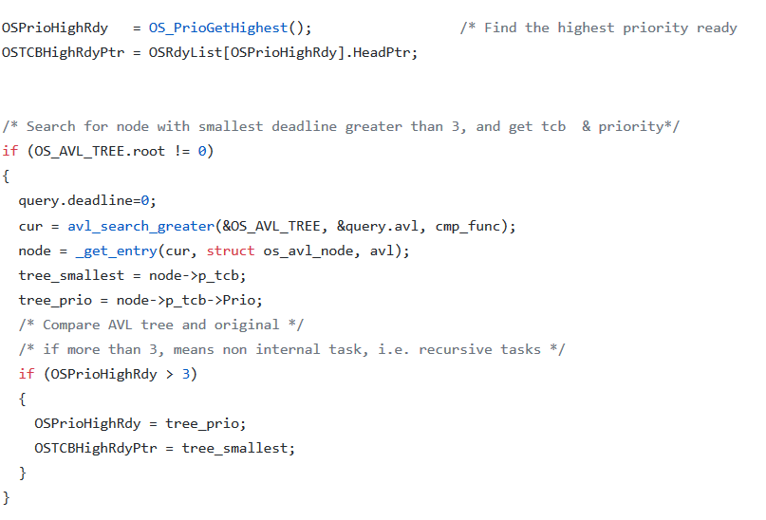
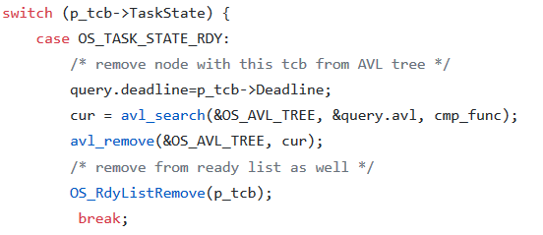
Earliest Deadline First
Changes to OSSched()
Take TCB with smallest deadline & priority
Compare with original OSPrioHighPtr
If OSPrioHighPtr >3, overwrite OSTCBHighRdyPtr with TCB from tree
When task ends, TCB removed from AVL tree
When task is re-released, TCB added to AVL tree

Slide 11
Overheads
Average time measured using CPU_TS_Get32().
Main additional overhead
OSRecTaskCreate run once at start
OSRecTaskDel run everytime task ends
Popping and pushing from the heap.
OS_revive_rec_task that runs every time OS_TickTask is run

Slide 12
Function | Time (cycles) | Function | Time (cycles) | Function | Time (cycles)
OSTaskCreate | 1350 | OSRecTaskCreate | 1350 | avl_insert() | 200
OSTaskDel | 512 | OSRecTaskDel | 736 | avl_remove() | 380
heap_pop | 120 | heap_push | 45 | OS_revive_rec_task (synch release for 5 tasks) | 3000
OS_revive_rec_task (PER task to revive) | 2200 | OS_revive_rec_task (no tasks to revive) | 32

Slide 13
Fin

